Slide 1
Decoding Mutual Fund Performance: Dynamic Return Patterns via Deep Learning
Norman Guo
Georgia State University
Notes:
Good Morning Everyone! First of all, thank you so much for being here given that it’s only 8:30 in the morning. And thank you so much to Professor Wang for organizing the session. It’s pleasure to be able to talk about this paper. I am currently a fourth-year PhD student at GSU. One of my research interest is to uncover innovation in financial services driven by new technologies or new investment vehicle like ETFs. This is one of the related projects I am working on and actually is also my second-year paper.
I came up with this idea when I read WSJ which mentioned that some Mutual funds hold ETFs.

Slide 2
Motivation
Mutual fund performance is not persistent overtime
Mutual fund managers have limited skill or no skill
Mutual fund managers have time-varying skill
Mutual fund managers may adopt different and dynamic strategies in different economic states

Slide 3
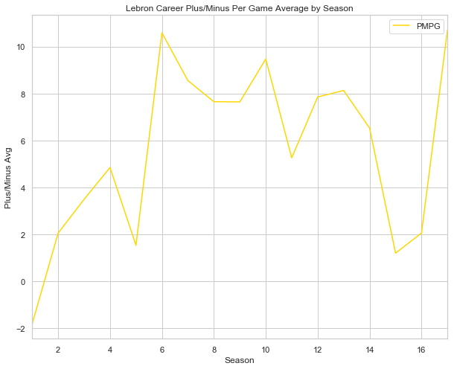
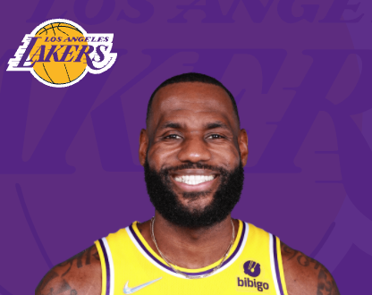
Performance of NBA Player
Season | Game Score
Regular Season | 21.7
Playoff Season | 25.2
Time | Game Score
First Quarter | 20.4
Last 3 Minutes | 32.3

Slide 4
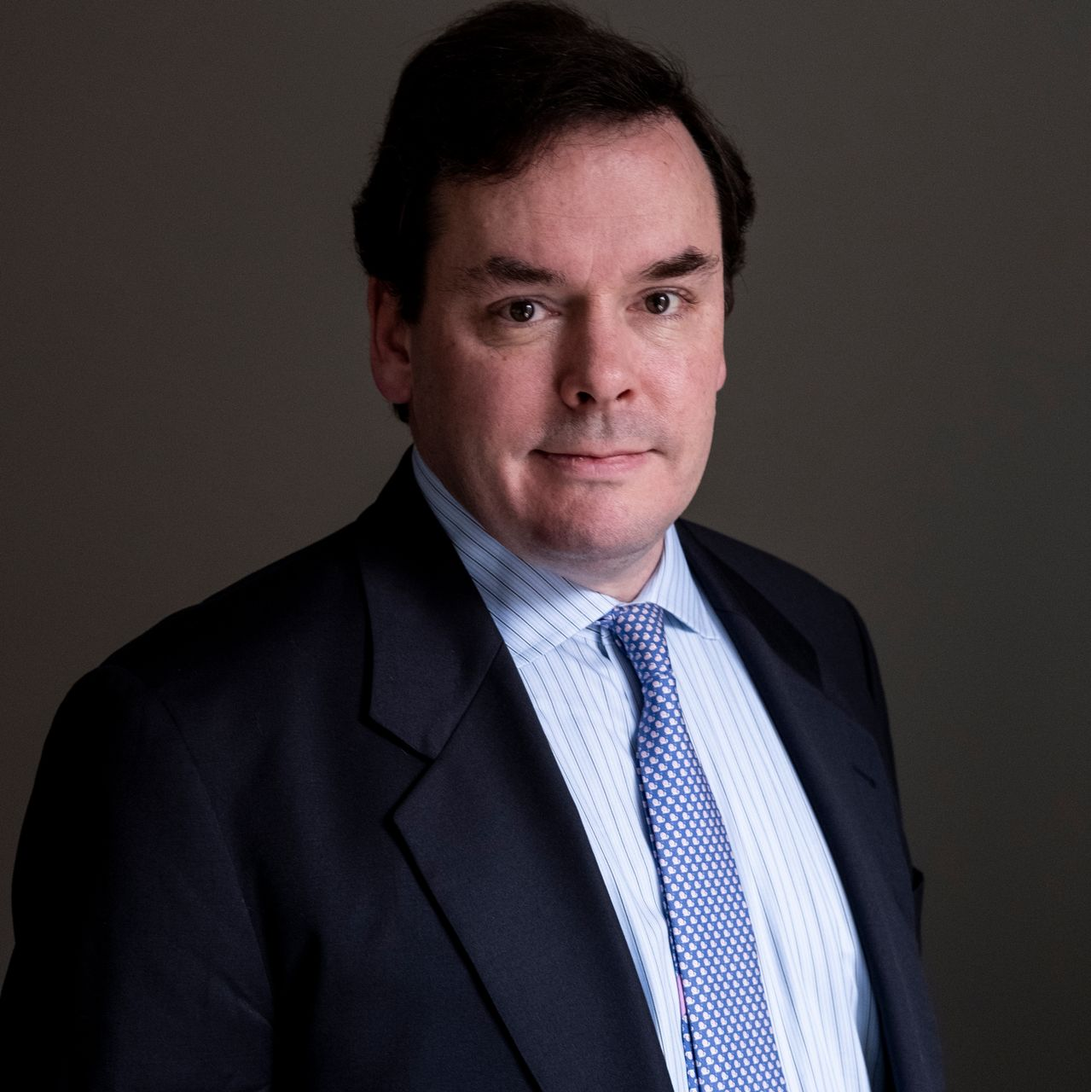
Performance of Mutual Fund Manager
Market Condition | Rank on Four-factor Alpha
Recession | 10 percentile
Boom | 50 percentile
Inflation | Rank on Four-factor Alpha
High Inflation | 20 percentile
Low Inflation | 40 percentile

Slide 5
Performance of Mutual Fund Manager
“A sailor cannot control the wind, but she can determine how to take advantage of it to get her where she wants. Good investment strategy is to stick with the approach over the long run. This discipline applies not only to staying with your positions. It also means re-entering the markets when your approach calls for it, even though uncertainties may still exist.”
Market Condition | Rank on Four-factor Alpha
Recession | 10 percentile
Boom | 50 percentile
Inflation | Rank on Four-factor Alpha
High Inflation | 20 percentile
Low Inflation | 40 percentile

Slide 6
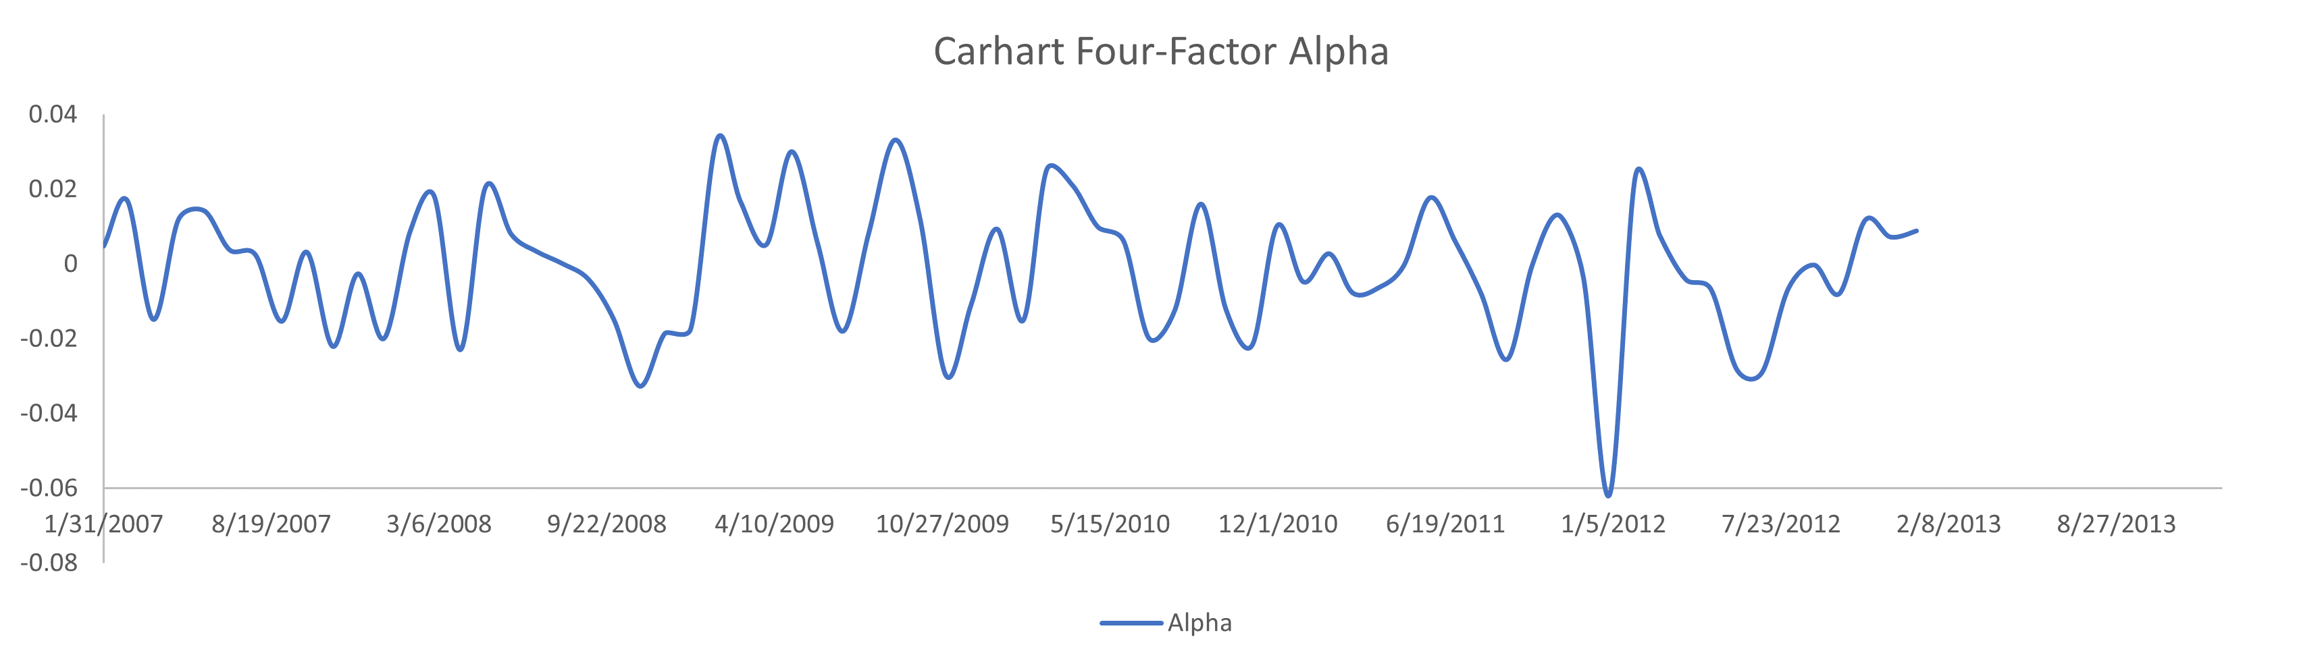
Can We Eyeball to Find Any Pattern?
?

Slide 7
Machine Can!
T-bill Yield
Market Return
Term Spread

Slide 8
Machine Can!
T-bill Yield
Market Return
Term Spread
“…over a longer period of time, there is no question that things are improving. The recession officially came to an end, driven by what has now been six consecutive quarters of growth.”
- Shareholder Letter 2011
“The Federal Reserve held benchmark interest rates to a low target range of 0% to 0.25% and pursued other initiatives designed to inject liquidity into the financial system.”
- Shareholder Letter 2010
“The Fed stated that its objective is to lower longer-term bond yields while maintaining short-term rates at their current and historically low levels.”
- Shareholder Letter 2012

Slide 9
Research Questions
Can machines identify repeated patterns in fund returns?
Would such patterns be helpful to predict future fund performance?
What is the economics behind the pattern?

Slide 10
Main Results
Yes, machine can identify the hidden and repeated patterns.
Yes, such patterns can be used to predict future return.
A long-short portfolio based on the model’s prediction generates a 2.8% annualized Carhart 4-factor alpha.
This abnormal performance is persistent for up to four years.
Different from mutual fund measures in the literature.
The patterns are associated with the macro and fundamental strategies
Fund returns are most informative when they happen after earnings announcements
Historical performance and macroeconomic variables are the most important determinants of future fund return patterns and performance
Funds that are more impacted by macroeconomic variables can be better predicted in the model

Slide 11
Contributions
Persistence of mutual fund performance
Return pattern is persistent, detectable, and predictable
New measure of mutual fund skill
Measure under static model
Return Gap (Kacperczyk, Sialm, and Zheng, 2008)
Active Share (Cremers and Petajisto, 2009)
Industry Concentration (Kacperczyk, Sialm, and Zheng, 2011)
Provide a new measure of time-varying mutual fund skill that can be measured based only on past performance, macroeconomic conditions, and fund characteristics.

Slide 12
Contributions
New Machine learning framework in financial economics
Introduce a sequence-to-sequence model that is particularly suitable for capturing dynamic time-series patterns.
Customized machine learning model to handle different types of inputs.
Explainable intermediate outputs to open the black box of machine learning model.

Slide 13
Data and Features
Data Sources: CRSP Mutual Fund, Fed St. Louis
Sample: active U.S. equity funds from 1990m1 to 2019m12
Historical Mutual Fund Performance
Carhart four-factor alpha
Macro-level features
12 features
Including Inflation, Oil Prices, Term Spread, Default Spread, VIX, etc
Fund Characteristics
Fund Style, Fund Size, Fund Flow, Turnover Ratio, Cash, Manager Fee, Expense Ratio, Load, Manager Tenure
Factors
From Fama and French five-factor model and Hou, Xue, and Zhang q-factor model
Group into dynamic inputs, static inputs, and deterministic inputs in the model

Slide 14
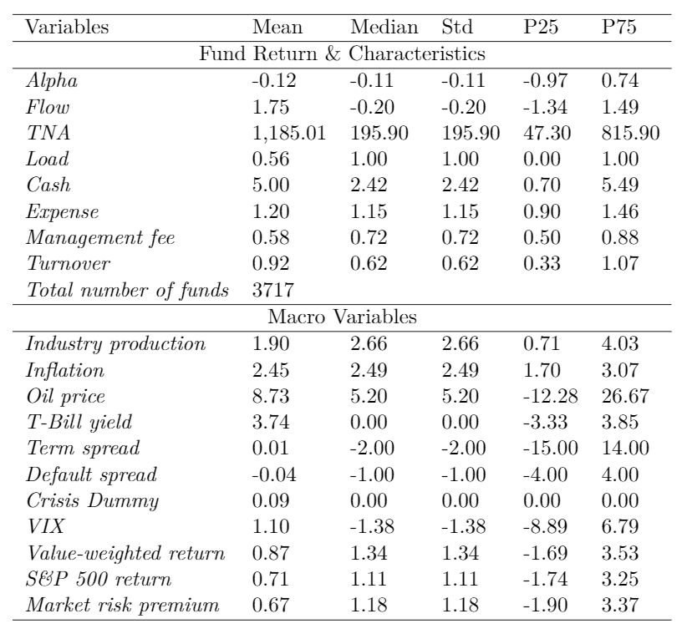
Summary Statistics

Slide 15
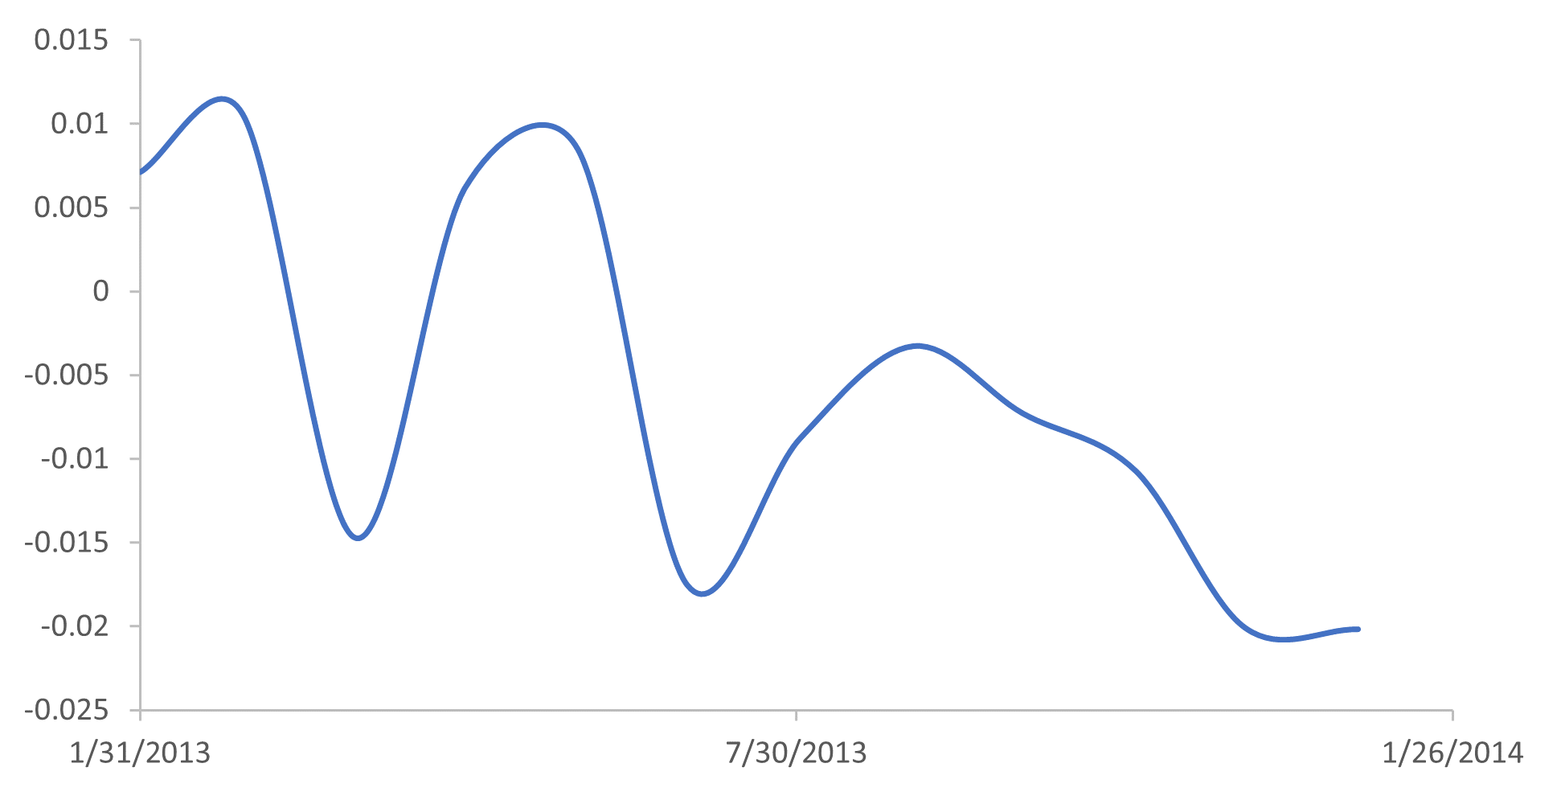
Temporal Fusion Transformers (TFT) Model
Originally used for language translation and prediction
TFT Model
Historical Alpha
Future Alpha

Slide 16
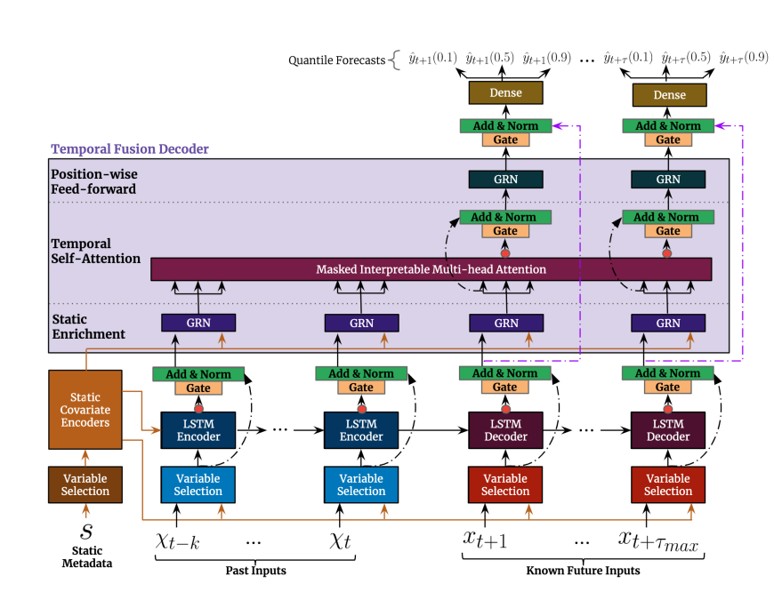
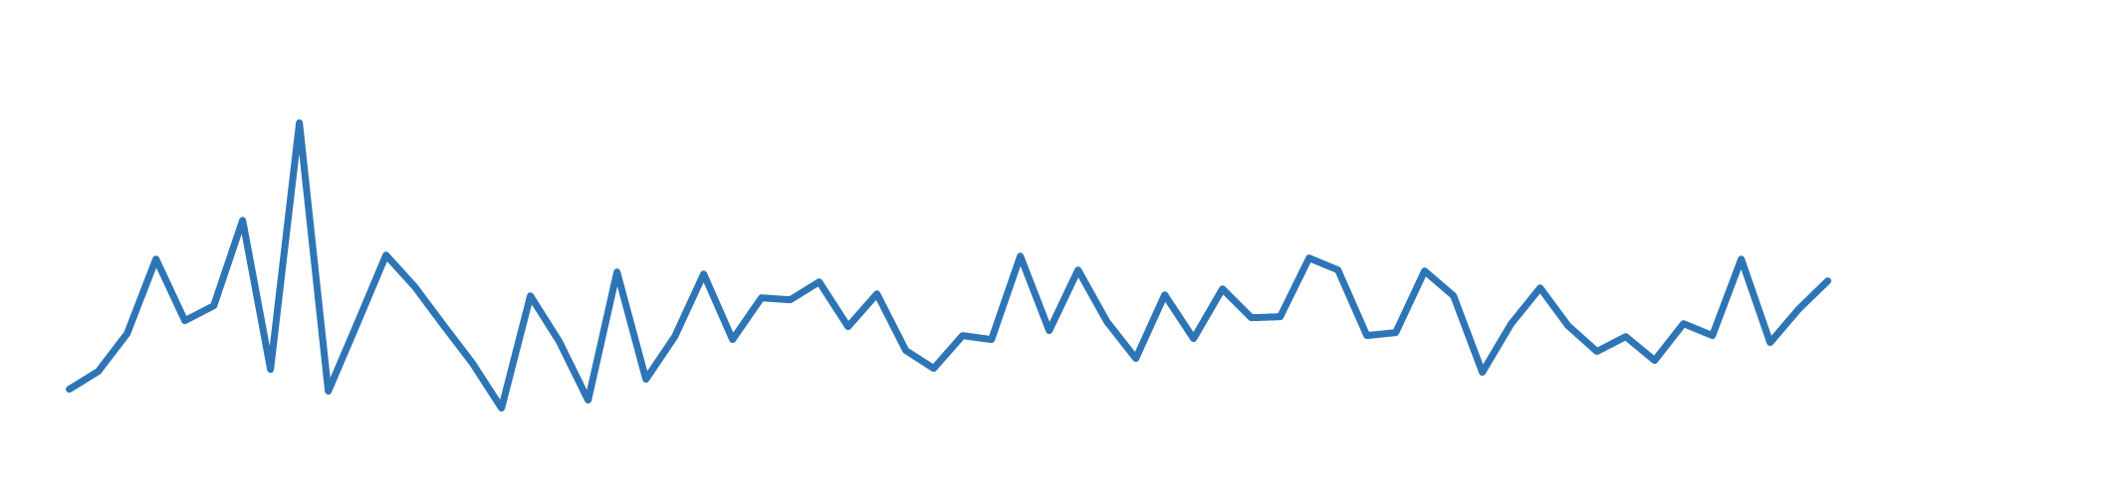
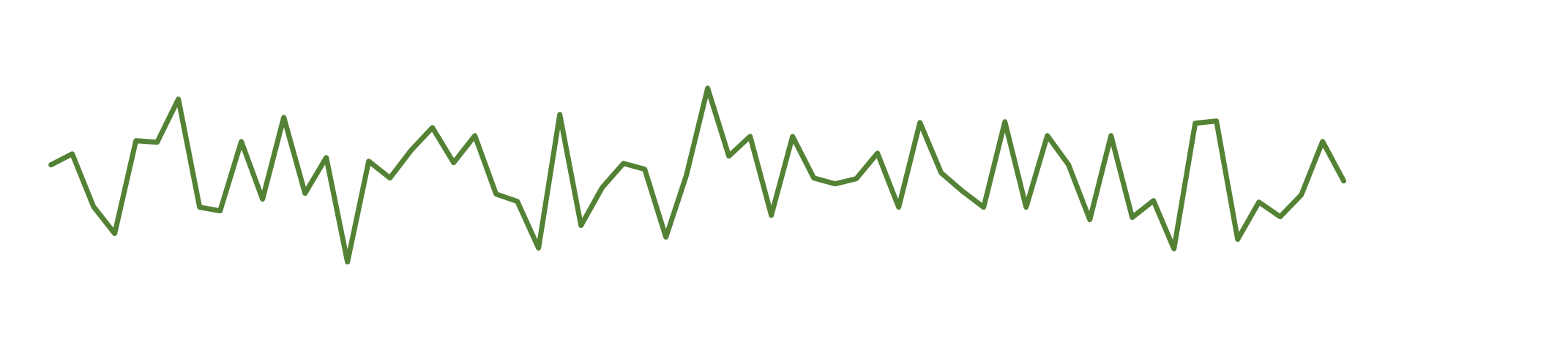
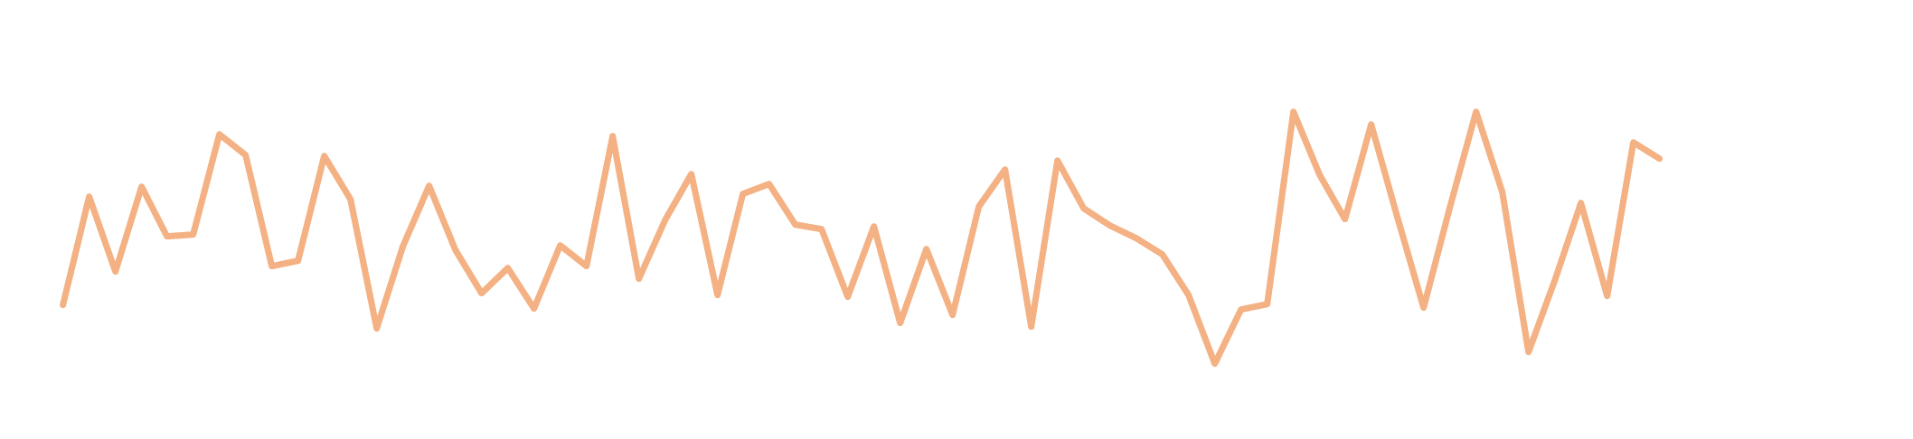



Structure of TFT Model
$×[w_{i,1}, w_{i,2},……,w_{i,t}$]
Variable Selection Module
$×[w_{j,1}, w_{j,2},……,w_{j,t}$]
$×[w_{k,1}, w_{k,2},……,w_{k,t}$]
Variable Selection

Slide 17



Structure of TFT Model
LSTM Encoder and Decoder
$$φ\left(t,n\right)∈\{φ\left(t,−k\right), ………………………………,φ\left(t,t_{max}\right)\}$$
LSTM Encoder
LSTM Decoder
$×[w_{i,1}, w_{i,2},……,w_{i,t}$]
$×[w_{j,1}, w_{j,2},……,w_{j,t}$]
$×[w_{k,1}, w_{k,2},……,w_{k,t}$]

Slide 18

Structure of TFT Model
Attention
$$φ\left(t,n\right)∈\{φ\left(t,−k\right), ………………………………,φ\left(t,t_{max}\right)\}$$

Slide 19

Structure of TFT Model
Output
Minimizing the quantile loss:

Slide 20
Predicting Mutual Fund Performance
72-month estimation horizon and 12-month prediction horizon
train ML model
tune ML model
Out-of-sample prediction
Training Samples
Validation Samples
Test Samples
1990m1
80% : 20%
2010m1
2020m1

Slide 21

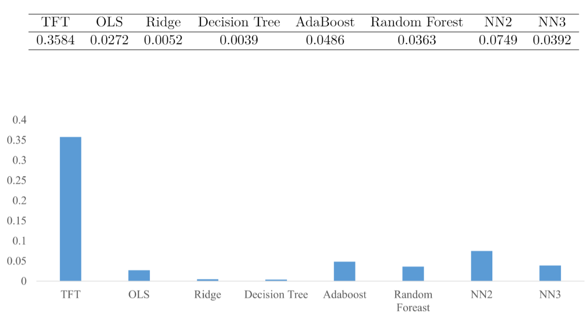
Comparison of Machine Learning Models
TFT model outperforms other benchmark models in out-of-sample $R^{2}$ following Gu, Kelly, and Xiu (2020):
Measure in percentage

Slide 22
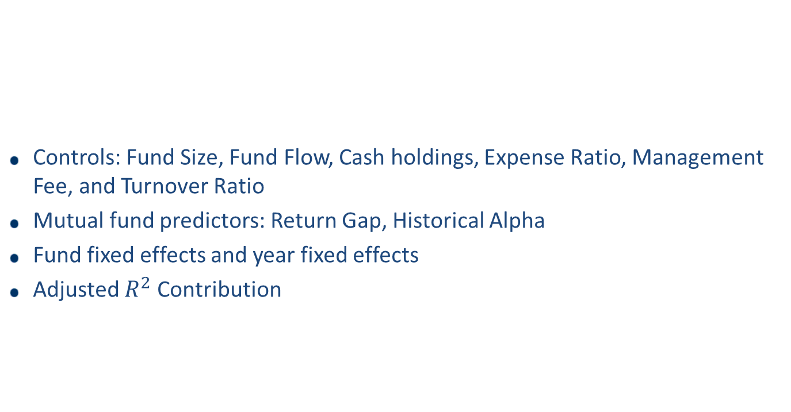
Predicting Power Analysis
Controls: Fund Size, Fund Flow, Cash holdings, Expense Ratio, Management Fee, and Turnover Ratio
Mutual fund predictors: Return Gap, Historical Alpha
Fund fixed effects and year fixed effects
Adjusted $R^{2}$ Contribution

Slide 23
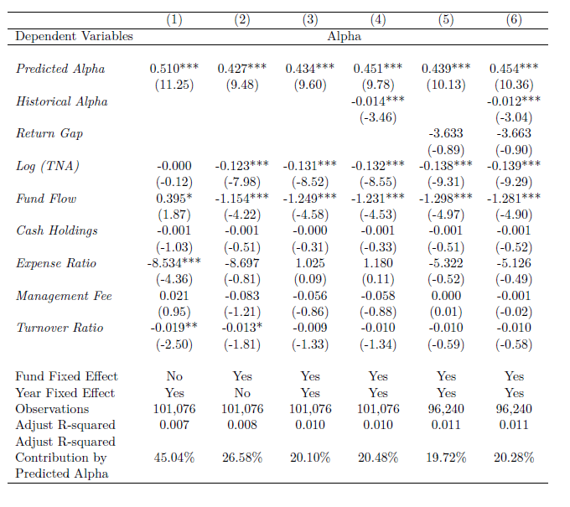
Predicting Power Analysis

Slide 24
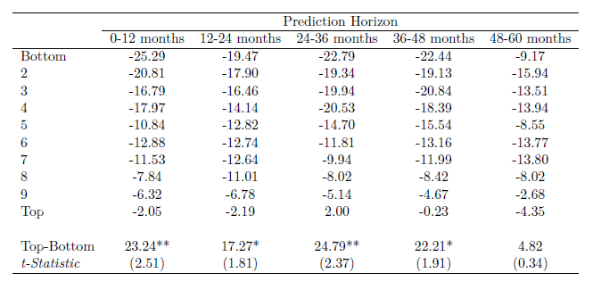
Portfolio Return and Persistence
Decile monthly rebalanced portfolio based on 12-month prediction.
Maintain the same weight construction of the first year to all future years.

Slide 25
Sources of Predicting Power
What’s the sources of predicting power?
From the cross-sectional performance differences across funds?
From a fund’s relative performance over time?
5 × 4 double-sorted portfolios
First sort cross-sectionally into quintile portfolios by the predicted average annual performance.
i.e., funds with annual performance in the top quintile are assigned to the top cross-sectional portfolio (p5)
Then sort timewise into quartile portfolios based on the relative predicted alpha of different months for the same fund.
i.e., fund’s top three performance months will be assigned to the top time-series portfolio (t4)
Sort cross-sectionally
Sort timewise
 | P1 | P2 | P3 | P4 | P5
T1 | Worst
T2
T3
T4 |  |  |  |  | Best

Slide 26
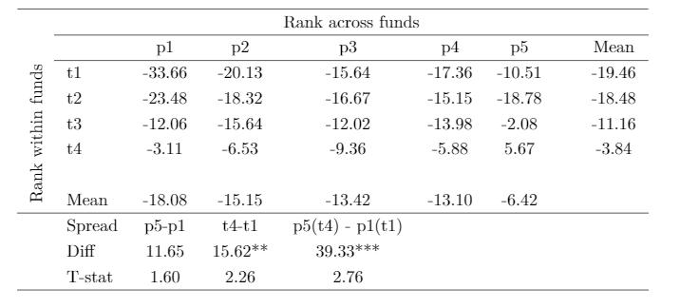
Sources of Predicting Power

Slide 27
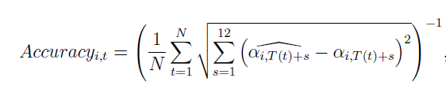
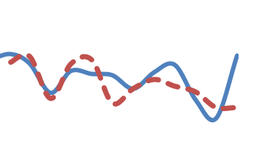
Prediction Accuracy
Measure pattern distance
Inverse of the mean Euclidean distance between:
Standardized actual alphas
Standardized predicted alphas

Slide 28
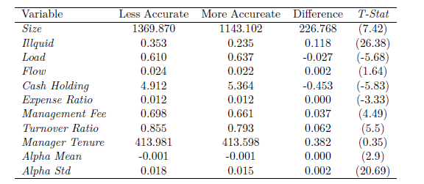
Prediction Accuracy
More accurately predicted funds tend to be smaller, more liquid, hold more cash, charge lower fees, trade less, and have less volatile returns.
Univariate Analysis of Prediction Accuracy

Slide 29
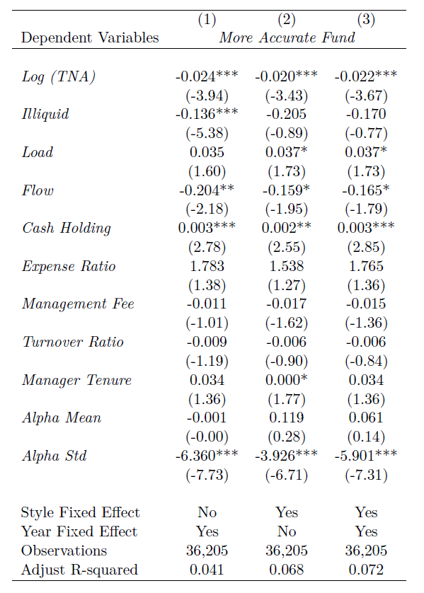
Regression Analysis
Multivariate Analysis of Prediction Accuracy

Slide 30
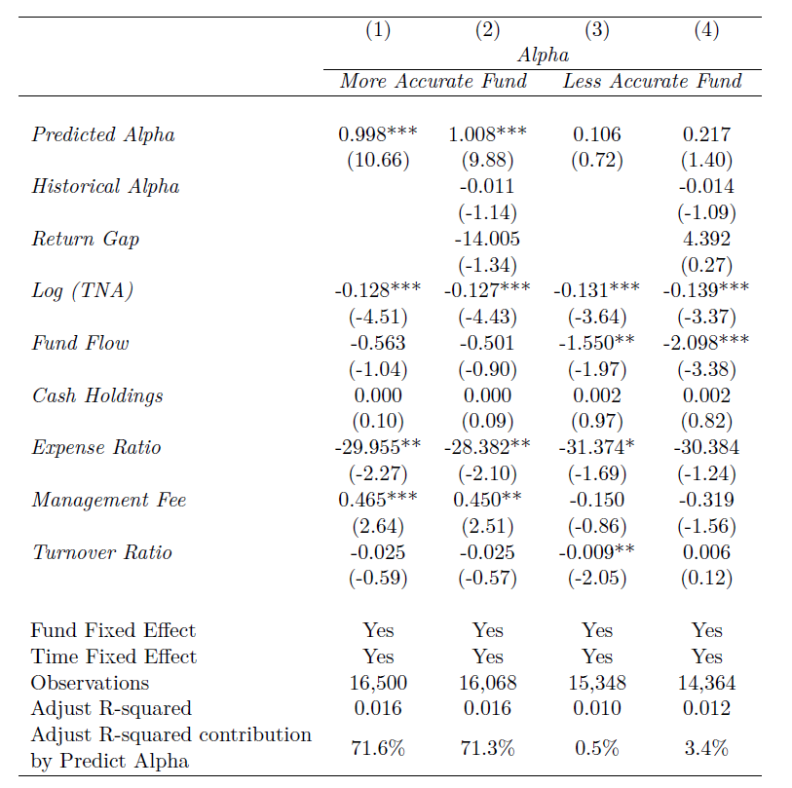
Prediction Power Analysis
Predicting power analysis for more and less accurate funds

Slide 31
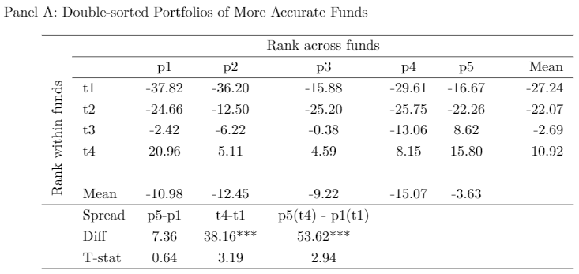
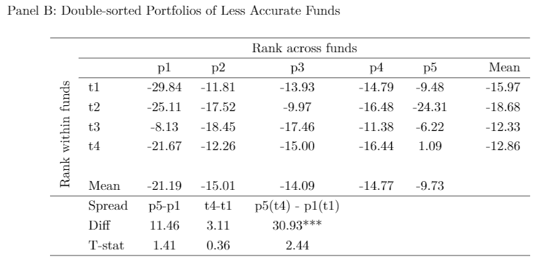
Prediction Accuracy and Portfolio Performance

Slide 32
Understanding and Interpreting the Model
Dynamic variable importance
Attention
The return patterns are associated with the macro and fundamental strategies
Fund returns are most informative when they happen after earnings announcements
Funds that are more impacted by macroeconomics variable can predict better in the model

Slide 33
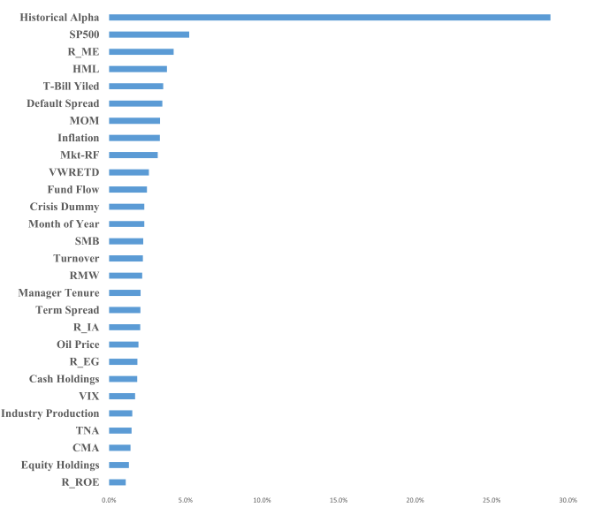
Variable Importance
Historical performance and macroeconomic variables are the most important determinants.

Slide 34
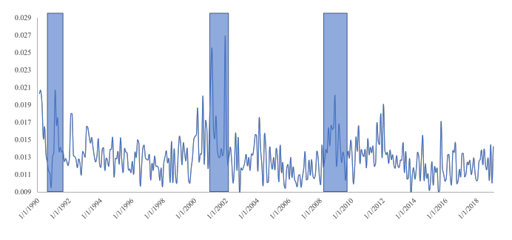
Time Series of Attention in the Model
Attention varies dramatically over time, and the months with the highest weights reside in the economic crisis periods
Macro conditions exert significant influence on the learning of return patterns

Slide 35
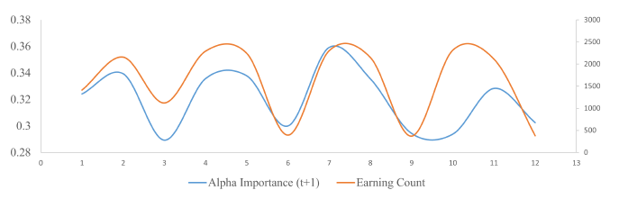
Alpha Importance and Earning Announcements
Alpha Importance
Variable importance of the historical alpha in the model.
Number of earning announcements made by companies held by funds
Pinnuck (2005): Earnings information explains approximately 25% of a mutual fund's average monthly abnormal performance

Slide 36
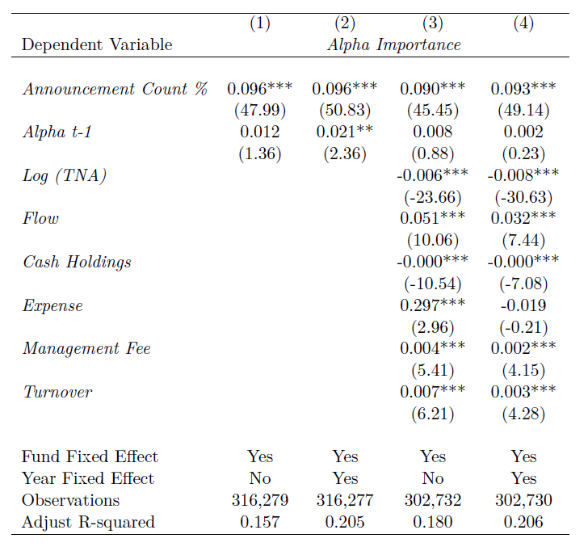
Alpha Importance and Earning Announcements

Slide 37
Model Prediction
Alpha Importance
Variable importance of the historical alpha in the model.
Related to fundamental (bottom-up) investment strategy.
Macro Importance
Sum of the variable importance of the macroeconomics variables in the model
Related to macro (top-down) investment strategy.

Slide 38
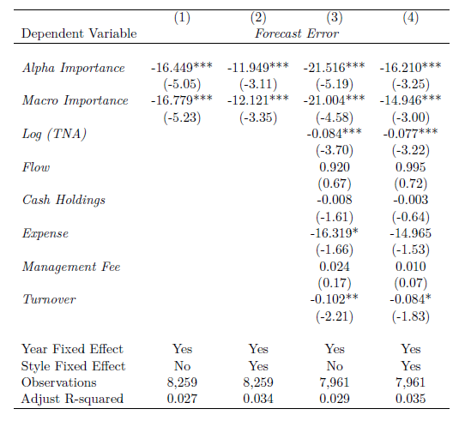
Model Prediction

Slide 39
More Tests
Combine with holding information
Turnover is higher during high attention period
Fund Level, Manager Level, or Stock Level
Form 1000 hypothetical buy and hold portfolio of 100 stocks in S&P 500 index
Categorize fund into major investment strategy
Partial dependent test

Slide 40
Conclusion
State-of-the-art deep learning model to understand and predict dynamic patterns in mutual fund returns
Model can identify hidden and repeated patterns.
The patterns can be used to persistently predict future returns.
The return patterns are associated with the macro and fundamental strategies
Fund returns are most informative when they happen after earnings announcements
Funds that are more impacted by macroeconomic variables can be better predicted in the model
A new machine learning framework in financial economics

